Slide 1
Local Development Plans & Economic Development
Dr Chris Boomer
Development Plans Manager
(DoE Northern Ireland)

Slide 2
The role of the Local Development Plan is to provide:
a strategy to accommodate economic growth that
tackles disadvantage and creating jobs
builds economic hubs and sustains a vibrant rural community
links with investment in infrastructure, transportation and other land uses;
is sensitive to the environment
local policies and proposals that
delivers a generous supply of economic development land
offers a range and choice of sites and locations
takes into account local challenges and opportunities
Is appropriate in nature, scale and design appropriate to its locality.
But does experience suggest we so this?

Slide 3
No, therefore we need to address:
What’s wrong with N.I Plan making system
Introduce a new effective Local Development system.
Prepare Councils for the introduction of that system
Build multi disciplined at local level teams, focussed on sustainable economic development and linked to better linked to the communities they serve.

Slide 4
A top heavy planning system
PROGRAMME FOR GOVERNMENT
REGIONAL DEVELOPMENT STRATEGY
PLANNING POLICY STATEMENTS
AREA PLANS, LOCAL & SUBJECT PLANS

Slide 5
What else is wrong
Slow / inefficient
detail obscures vision and strategy
Voluminous and hard to understand,
No balance of environment, social and economic factors
Lacks meaningful public engagement
Public examinations too long
Not joined up, not delivered and not central to decision making
Inadequate monitoring and review.

Slide 6
Objectives of the new system
Vision &
Strategy
Co-ordinated
Monitored
Reviewed
Localism,
Place Shaping
& Regeneration
Local
Development
Plan
Evidence based /
Sustainability
Assessed
Better
Community
Engagement

Slide 7
Steps for successful change
STEP 1 Provide the resources –
Build, train, transfer and continue to fund Plan teams
STEP 2 – Introduce legislative change –
Planning Act NI 2011
Draft Planning (Local Development Plan) Regulations (NI) 2015
Draft Planning (Statement of Community involvement) Regulations 2015
STEP 3 – Provide policy to encourage local initiative
Revised Regional Development Strategy,
Draft Strategic Planning Policy Statement
STEP 4 - Prepare Key Players – The Preparatory Studies
Build Capacity,
Inform and empower,
Create multi-disciplined teams

Slide 8
Statutory requirements
A Plan Led System – applications determined in accordance with the development plan unless material considerations indicate otherwise
A Two Tier Approach comprising:
Plan Strategy – Sets vision, objectives and growth strategy and general strategic policies having regard to the Regional Policy
Local Policies Plan – Sets local policies & proposals including settlement limits, zonings and designations consistent with Plan Strategy.

Slide 9
Statutory Requirements
Timetable - Of key publication dates based on project managed approach.
Statement of Community Involvement – setting out who, how, where and when consultation and policy making is to take place.
Preferred Options Paper – Front loading consultation process

Slide 10
Sustainability Appraisal
A Holistic, multi-disciplined, ongoing approach
incorporating Strategic Environmental Assessment and Equality Impact Assessment
Based on Economic, Social and Environmental Objectives
Assessment of Options, outcomes and mitigation

Slide 11
Public Examinations and adoption
Public Examinations to focus on soundness
Are policies and proposals evidence based ?
Has adequate account been taken of regional policies?
Representations to provide robust solutions
Departmental Direction
Public Examination to report to the Department
Adopt, modify or withdraw

Slide 12
Post adoption
Preferred Options Paper
Plan Strategy
Regular reviews (at least every 5 years)
Flexibility
for change
Site Specific Policies and Proposals
Annual Monitoring

Slide 13
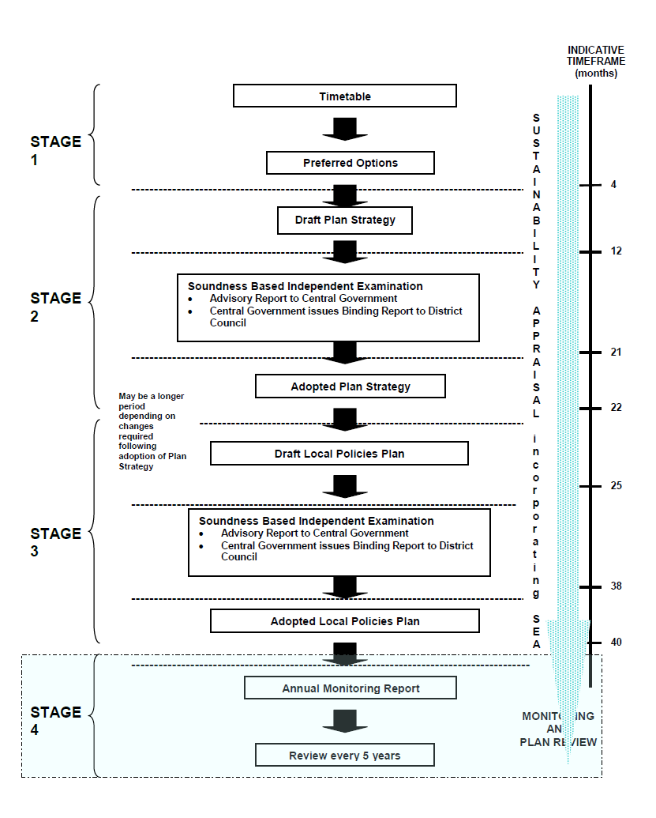

Slide 14
How will this be achieved
With the aid of:
Preparatory Studies identifying:
a growth strategy to meet the populations needs including disadvantaged/under-represented groups
availability of existing and need for additional housing and economic development land.
Research into planning issues identified by Council Members

Slide 15
Linking land use to Infrastructure
Using the :
Regional and Sub Regional Transportation Plans (DRD)
Other infrastructural plans by other Departments
Supported by transparent government
Identify issues such as adequacy of infrastructure and any investment to address (NIW)
The state of the environment (NIEA)

Slide 16
But more importantly
Use the Community Plan:
Apply its vision to the Plan Strategy
Address its objectives when formulating local policies and proposals
Link its programme of public investment to land needed for:
health, education, and other public services
Leisure recreation and tourism
Local economic development

Slide 17
Putting it into practice
Listen to the patient -
Is existing policy failing, are we helping or preventing sustainable economic development.
Diagnose the problem -
Identify where deprivation occurs, the no and type of jobs needed, translate into land requirements.
Monitor the condition -
How much land is available, and is it developable.
Formulate a care strategy -
Taking into account national trends and opportunities, new infrastructure and new technology
Focus on the strengths of the local economy
Administer the treatment –
Formulate policy to meet large and small businesses, particularly local businesses.
Zone land economic development in locations easily accessed, with minimum constraint.
Provide guidance on how that developed.
Monitor and review
Are there more jobs is deprivation being addressed, do we need to change the plan.
And it still may not be the cure

Slide 18
But it is better
R
Council’s
Corporate Plan
Local
Development Plan
Community
Plan
Regional Policy Context

