Slide 1
Preparing a Development Plan
A councillor’s view

Slide 2
A vision of
The future spatial development of your area
The economy
The infrastructure
The urban centres
The recreational areas
The architecture
The heritage

Slide 3
Not a blank canvas
A plethora of strategies
Regional Planning Guidelines
Housing Strategy
Density Guidelines
Retail Strategy
Flood risk
National Transport and Roads Strategy
Anti-poverty strategy
EU directives
Appropriate assessments
National Climate Change strategy
Strategic Environmental Assessments

Slide 4
And you are not alone
Planners
Investors
Landowners
Developers
Community
Prescribed bodies
Councillors

Slide 5
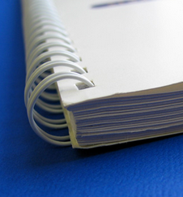
The Plan
The written statement
The maps

Slide 6
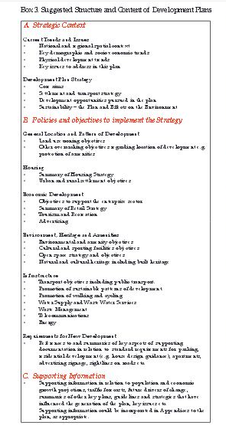
The written statement
Strategic Context
Current Trends and Issues
Development Plan Strategy
Policies and Objectives
Land use zoning objectives
Housing, Urban and Rural
Economic Development
Enterprise
Retail
Tourism
Environmental, Heritage and Amenities
Infrastructure
Supporting information
Population and economic projections

Slide 7
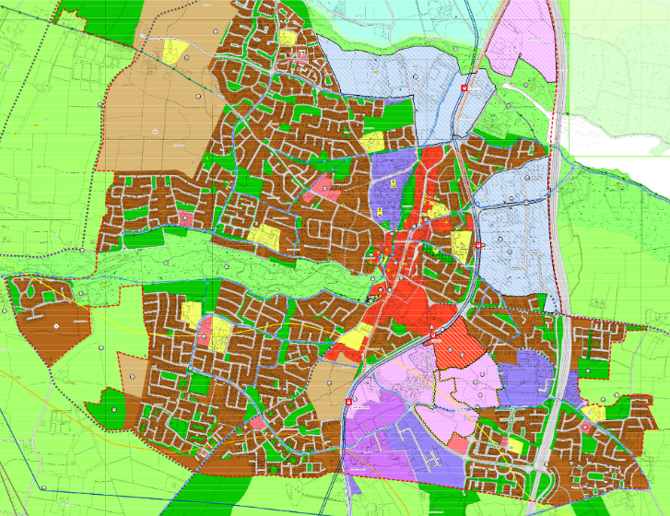
Maps - zoning

Slide 8
Development Plan Timeline
YEAR 1
Preparatory work
Draft Stage
(48 weeks)
9-16
17-38
39-46
47- 48
Public
consultation
Manager’s report on submissions
Prep. of Draft
Plan
Cllrs consider
Draft Plan
Prepare Draft for Public consultation
Weeks no. 1-8
9-16
17-38
39-46
47- 48
YEAR 2
Amended Draft Plan
(36 weeks)
Cllrs consider Manager’s Report
Prepare Draft
Amendments for
Public consultation
Public
consultation
Manager’s report on submissions
Weeks no. 49-58
59-70
71-82
83-85
Plan
Adopted
(14 weeks)
Cllrs consider Manager’s Report
Plan adopted (week 99)
Plan comes into effect (week 103)
Public
consultation
Manager’s report on submissions
86-89
90-93
94-99
Implementation
& monitoring
Notes:
20 weeks public consultation / 4 weeks after adoption Plan comes
into effect (no later than weekending 103)

Slide 9
Watch weasel words
Local area plans
Public consultation
It’s a plan not a permission
Quasi-judicial function
Development must be sustainable

