Slide 1
PLANNING IN SCOTLAND
Councillor Stephen Hagan
Cosla spokesperson for development, economy, and sustainability

Slide 2
supporting economic growth and regeneration through planning
My experiences as an elected member of how planning supports our economies and our communities within the broader context of ‘placemaking’
Some examples of our current partnership working arrangements with Scottish Government on planning matters
Some lessons learnt along the way

Slide 3
Planning for a sustainable future
Brundtland Sustainable Development principles:
Ensuring ‘decision making enables people to enjoy a better quality of life without compromising the quality of life of future generations’.
Scottish Government’s definition of sustainable economic growth:
‘Building a dynamic and growing economy that will provide prosperity and opportunities for all, while ensuring that future generations can enjoy a better quality of life too’.

Slide 4
CHALLENGES
Economies
Jobs
Broadband
Energy
Landscape
Town Centres
Communities
Transport

Slide 5
INFRASTRUCTURE
Money
Developers contributions
Tax Increment Financing
Community Benefits from renewables

Slide 6
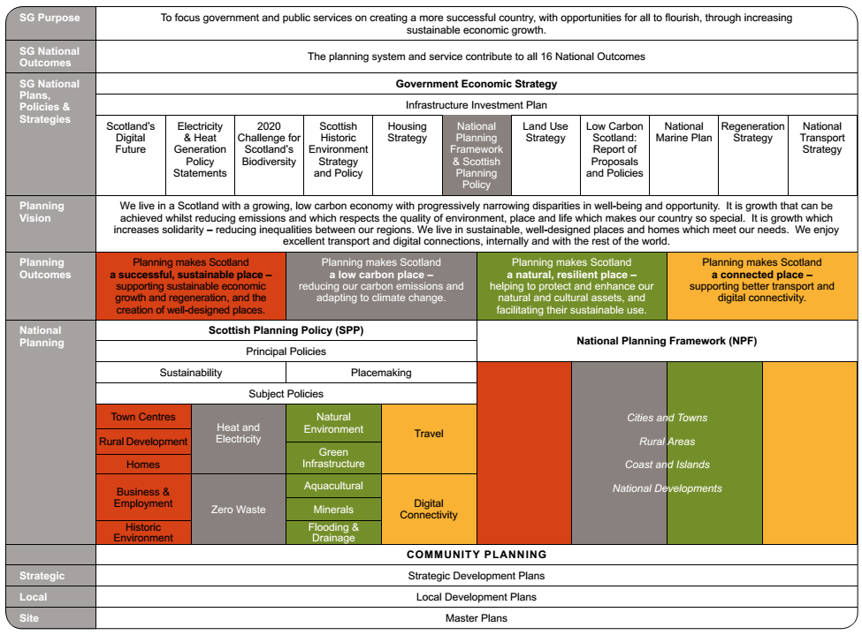
SCOTTISH PLANNING SYSTEM

Slide 7
Community Engagement
Community Planning
Development Planning
Social Media

Slide 8
The Standards Commission
Guidance for councillors
Early Engagement
Training for elected members

Slide 9
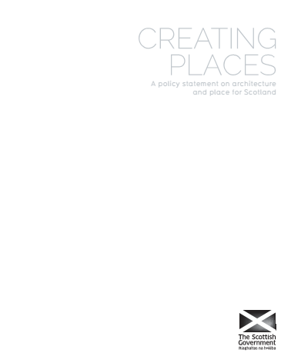
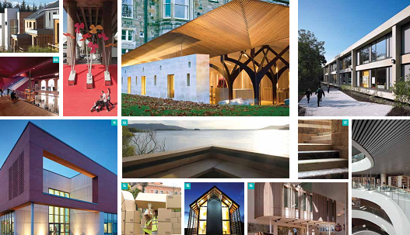
PlaceMaking
© Scottish Government

Slide 10
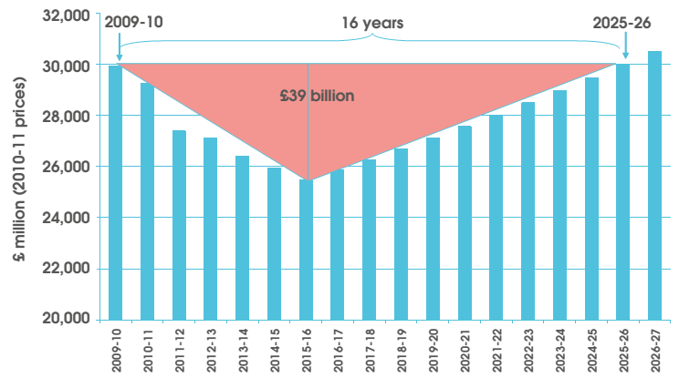
Financial Challenges facing local government
Illustrative Outlook for Scottish DEL Expenditure:
Source: Christie Commission 2011

Slide 11
Planning Roadshows

Slide 12
Partnership working
High Level Group on Planning
Resources
Fees
Performance

Slide 13
Lessons Learnt
Early elected member engagement in planning discussions
Clear guidance
Training
Partnership working arrangements with the Planning Minister
Fee levels adequately reflect costs

Slide 14
Thank You

