Slide 1


Overview of Spatial Planning Process in Northern Ireland: Past, Present and Future
Fiona McCandless
Chief Planner

Slide 2
History of Planning System in Northern Ireland
Prior 1973, planning powers were exercised through local councils
Post 1973, planning powers brought into central government & statutory requirement to CONSULT local Councils
Single planning authority with responsibility for:
Regional planning, policy development, legislation, development planning, conservation, development management including enforcement and regeneration.
Since 2007, Planning matters fall across 3 Departments – DOE, DRD, DSD – statutory consultation requirements retained
PAC – independent appellant body (OFMDFM)

Slide 3
The Big Drivers for Change –
North and South
  Global Financial Crisis
  Economic Recession
  Markets Decline (Jobs, Construction, Housing)
  Programme for Government (PfG)
  Local Government & Planning Reform
Notes:
A major reform programme for the planning system in Northern Ireland was originally announced in November 2007 and incorporates a range of medium to long-term measures designed to address all the key management elements of the planning system including development plans, policy and development management. The NI Executive agreed to the final policy proposals for reform of the planning system in February 2010, including the measures necessary to transfer the majority of planning functions to the new district councils.
The Planning (Northern Ireland) Act 2011 received Royal Assent on 4 May 2011.
The Act provides for the transfer of the majority of planning functions from central government to district councils as part of local government reform, as well as a number of reforms to the planning system.

Slide 4
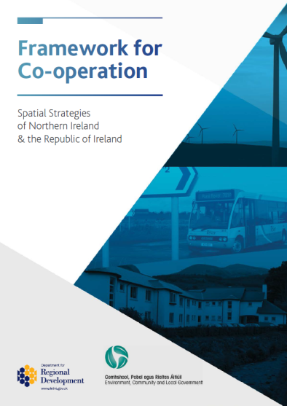
North-South Co-operation on Spatial Planning
Co-operation fosters a beneficial approach on cross boundary issues and projects and is accepted as good practice within the EU.
DRD’s Regional Development Strategy 2035 and DECLG’s National Spatial Strategy 2002-2020
NI Departments work closely with DECLG to implement the framework and with other organisations (e.g. ICBAN, East Border Region) to support a co-ordinated approach to regional planning

Slide 5
Current Planning System
Local Planning
Division
Strategic Planning
Division
Planning Policy
Division
Local Planning Offices
Belfast
Craigavon
Omagh
Enniskillen
Londonderry
Coleraine
Ballymena
Downpatrick
Causeway Exchange
Causeway Exchange
• 500 Staff

Slide 6

Improvements to the Existing System: Achievements 2013/2014
Programme for Government KC8
75% of Large scale investment decisions in 6 months
92% decided in 6 months

Slide 7
Business Plan Targets
Major 26 weeks not met
Intermediate 16 weeks exceeded
Minor 11weeks exceeded
29% reduction in applications >12 months

Slide 8
2013/2014
Applications received 11,634
Decisions issued 11,234
Applications approved 10,614

Slide 9

Planning Reform
Transfer of majority of planning functions to local government
Faster plans and processing of planning applications
Faster and Fairer Appeals
Simpler and Tougher Enforcement
Sustainable Development
Enhanced Community Development
Notes:
From April 2015, Councils will become the new planning authority – this will strengthen local democracy and put elected representatives at the heart of the planning system. Very different role for Councillors and planners. Councillors will have the recommendations of the professional planners but Councils will make the decisions for the greater good of their communities.

Slide 10
Planning Functions Transferring to Councils
Local Development Planning
Development Management
(excluding applications of regional significance)
Enforcement
(all breaches of planning control)
Conservation

Slide 11
New Development Management System
Create positive development management culture
Proportionate processes and decision making at appropriate level through new 3 tier hierarchy
Councils determine major & local developments – DOE regionally significant through direct submission or call-in
Early pre-application engagement and enhanced transparency (including predetermination hearings)

Slide 12
New Development Plan System
New plan-led system to provide greater certainty for all
Streamlined and flexible plan system
New 2 document approach (Plan Strategy & Local Policies Plan)
Overall timeframe reduced
More effective participation from public & stakeholders early in process

Slide 13

Simpler & Tougher Enforcement
Period in which enforcement action can be taken changed to 5 years (previously 4 and 10 years)
Introduction of Fixed Penalty Notices for failure to comply with enforcement of breach of condition notices
Multiple fees for retrospective applications

Slide 14
Practical Arrangements for Transfer
Strategic Planning Policy Statement
  Shorter, simplified planning policy.
  Introduces 8 core planning principles + new town & retail policy.
  Consultation on draft SPPS closed end of April 2014.
  Over 700 responses were received.

Slide 15
Practical Arrangements for Transfer
Staffing
  Workforce Models and Staff Preference Scheme
Legislation
  Primary powers established under Planning Act (NI) 2011.
  24 pieces of Subordinate Legislation.
  Consulting in 2 Phases to test proposals and seek informed responses.
  Aim to have all in place by year end.
Code of Conduct
  Councillors required to adhere to mandatory Code of Conduct – recently laid before Assembly
  Planning section comes into effect on 1 April 2015
  Supplementary Guidance being developed

Slide 16
Practical Arrangements for Transfer
Capacity Building and Training
  Planning specific capacity building and training programme for all Elected Members being finalised
  Training for Council and Planning staff being developed
Early Implementation Pilot - Newry, Mourne & Down
  Key issues are being identified in relation to timing, accommodation, IT provision, HR matters, costs and funding, etc.
  Lessons learned report will be shared with other clusters.

Slide 17
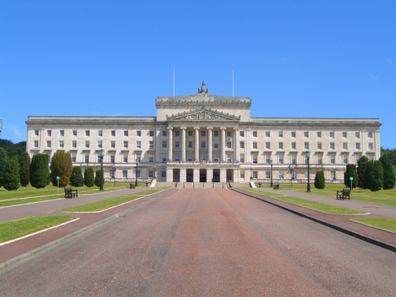
What stays with DOE?
Planning legislation, policy and guidance
Regionally significant planning applications
Statutory listing of buildings of special architecture or historic interest
Fee setting, funding, grant making powers
Oversight role with audit, inspection & performance management of councils
Selective reserve powers e.g. to take enforcement action

Slide 18
Reform Across the Island – Opportunities and Challenges
Opportunities:
Bringing decision making closer to communities and citizens
Stronger and more effective local democracy
Service delivery improvement - influence
place shaping and facilitate greater
integration
Challenges:
Changing roles
Balancing the local with the strategic

Slide 19
Future Vision - Planning in Local Government
Councils making plans
Councillors making planning decisions
Community planning
Connections with other functions
Delivering for community
Connection with place
Civic Leadership

